Slide 1
AISA Virtual Schools Collaborative –
Supporting Online Learning into the Next School Year

Slide 2
Who We Are
We are committed to making it easier for educators to individualize learning for every student through:
1
Digital curriculum that is rigorously aligned to state standards and used in blended and virtual learning environments.
Digital Curriculum
Proven Assessments
2
Assessments supported by strong validity and reliability, used for classroom practice, formative assessment, and benchmarking.
3
Managed services and consulting for comprehensive program design, implementation, support, and evaluation.
Educational Consulting

Slide 3
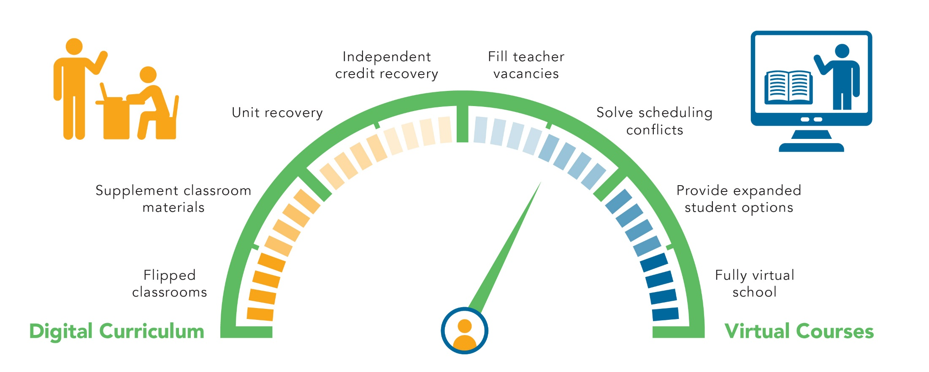
Gear Up Your Virtual Learning Program

Slide 4
A Fully-Accredited Virtual School Program
Edmentum partners with schools and districts to deliver rigorous and research-based curriculum built to state and national standards.
High-quality, state-certified teachers experienced in online instruction
Flexible program implementation and management designed for virtual learning
Accredited by Cognia (formerly AdvancEd)
End-to-end managed educational services
90%
passing rate
80%
course completion
50K+
enrollments annually
70+
full time teachers &
100+ part time teachers

Slide 5
Who Does EdOptions Academy Support?
Elementary Instruction
EdOptions Academy & Calvert Learning
Core Curriculum, College Readiness, and CTE Prep
EdOptions Academy
Workforce Preparation
EdOptions Career Academy
Who: Elementary schools
What: Carefully curated curriculum for elementary learners that incorporates problem-based instruction and blends online and print-based learning tools.
Who: Middle and high schools
What: Over 100 semesters of courses in core subject areas, over 100 semesters of CTE offerings, 27 semesters of college prep courses, and more.
Who: High school and adult learning programs
What: Career preparation in 10 vocational areas, including home care professional, office management, customer service, hospitality, food services, commercial driving, and more.
K-12 online courses paired with instructional services to deliver effective virtual programs
24/7 Tutoring | Success Coaching | Marketing & Enrollment Services | Special Education | ELL | IEP & 504 Planning | Gifted & Talented | Graduation Assistance

Slide 6
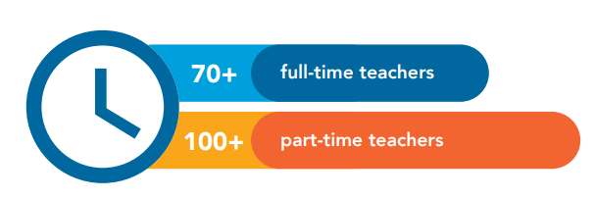
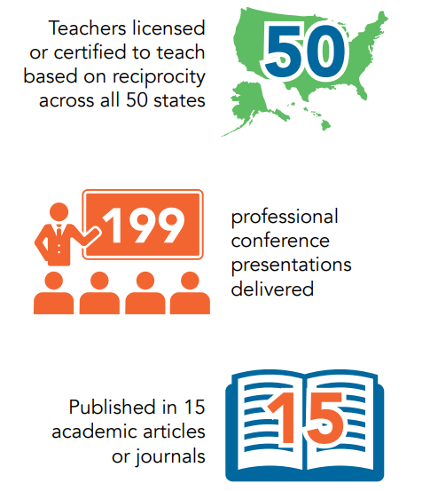
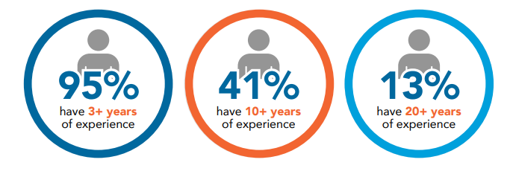
Who are EdOptions Academy Instructors?
“
”
EdOptions Academy makes it possible for students to have an educational experience that is tailored to their needs and/or preferences.
- Michaela Kenon, EdOptions Academy Math, German, and CTE Teacher

Slide 7
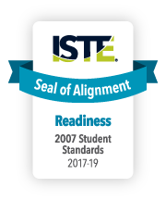
Internationally-Recognized Quality
We are the industry leader in standards-based online curriculum and are continually reviewing state and third-party lists to ensure that we are meeting relevant standards and providing learners with engaging, meaningful online experiences.
Notes:
We work closely with these agencies to make sure that our curriculum meets relevant standards from a content, technology, and accessibility standpoint. As a result, educators can save time and already scarce resources by being able to rest assured that Edmentum curriculum is rigorous, engaging, up-to-date, and aligned to standards.
*Click space bar for logos to appear*
Received the ISTE Seal of Alignment for Readiness
Are aligned to iNACOL standards
Have been accredited by AdvancEd
Earned a perfect score on recertification from Quality Matters

Slide 8
Needs going into next school year
Scaling to efficient delivery of Blended/Virtual Instruction
Teachers needed
Assign an Edmentum Certified Teacher to any of our 400+ courses
U.S. certified teacher with curriculum assigned to students
Building Capacity
Professional Development for your staff to deliver online content
Your teacher is assigned a “mentor teacher”
Instructional Support
Teacher assistance to ensure classroom success
Access to online curriculum for grades k-12
Additional student assistance to increase student engagement
Tutoring
Free to any student that is taught by Edmentum’s teachers
36/1 student to teacher ratio
Can be used for individual courses or for a “fulltime enrollment”
Your teachers complete a professional development plan, receiving a certification at competition.
Access to online curriculum to deliver to your students through a blended or virtual environment
Edmentum’s teachers will grade all material and provide feedback, while your teacher facilitates the classroom.
All students receive a certificate of completion when the finish a course.
For an additional fee tutoring can be extended to 24/7
Tutoring can be purchased to be used with or without Edmentum teachers

Slide 9
Needs going into next school year
Scaling to efficient delivery of Blended/Virtual Instruction
Solution | Description | Fulltime (6 courses) | Per course
Teacher Needed | Using Edmentum’s teacher of record. Includes curriculum and support. K-12 | $2500 a year per student | $250 a semester per student (a lower rate applies for grades k-5)
Building capacity | Includes curriculum. Each teacher receives professional development Teachers are assigned a mentor teacher for the entire school year to assist. | $700 a year per student | $130 per semester per student (k-12)
Instructional support | Edmentum teachers grade all material within content and provide students feedback. Price does not include curriculum | $799 a year/ per student | $199 a year per student
Tutoring | 24/7 tutoring core subject areas 10 hours cumulative | $250

Slide 11
Thank You for Your Time
Please visit our website www.edmentuminternational.com for more information on how we support the use of data to inform teaching and learning.
Derek Devine
Email: derek.devine@edmentum.com
Website: www.edmentuminternational.com
Follow Edmentum International on Facebook, Twitter or LinkedIn.

